Slide 1
Used Cars Price Analysis
Submitted by: Gajulapalli Hema,
Data Analyst – ExcellenC,
hemagajulapalli24@gmail.com.

Slide 2
Problem Statement
Car price variation based on various car brands.
Best cars with good quality with less price.

Slide 3
Project Objectives
Analyze price trends among used car brands.
Evaluate fuel types, EMI options, and other key features.
Recommend best value-for-money used cars.

Slide 4
Data Collection (Web Scraping)
Data collected from Car Dekho platform.
Used Python libraries:
- requests: to send HTTP requests
- BeautifulSoup: to parse HTML content
- re: to extract year using regular expressions
- openpyxl: to store data in Excel format
Extracted fields: Year, Name, Price, Mileage, Fuel, Transmission
Saved data to Hema_project.xlsx

Slide 5
Data Cleaning & Preparation
Removed duplicates and missing values.
Standardized units and converted text to numeric.
Cleaned data using power bi.

Slide 6
Tools Used
Python (for web scraping).
Excel (preprocessing).
Power BI (for data cleaning ,visualization and analysis).

Slide 7
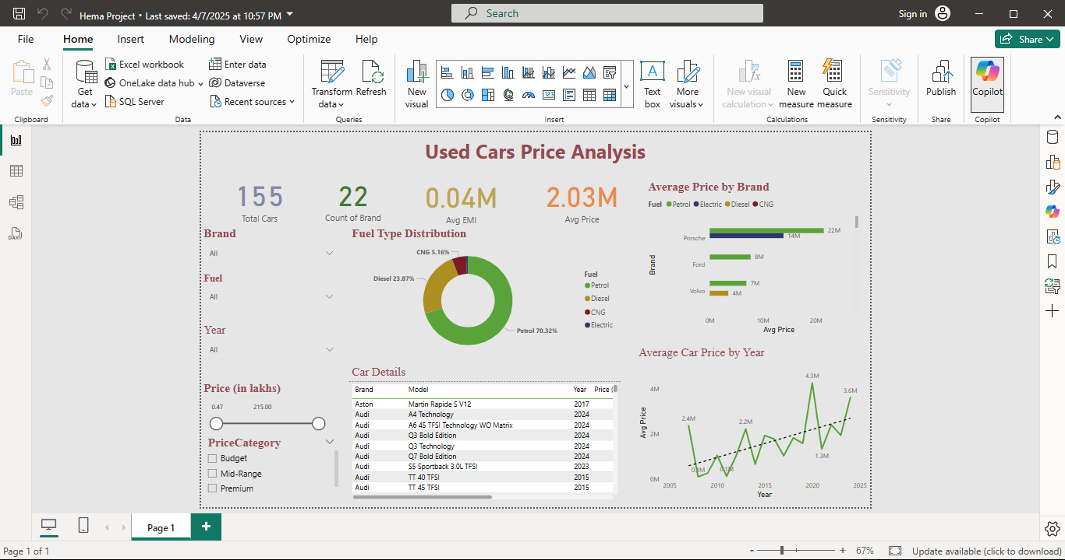

Slide 8
Challenges Faced
Data inconsistency and formatting issues.
Handling missing values.
Web scraping limitations and website structure changes.

Slide 9
Conclusion
Identified best value-for-money used cars.
Top performing brands analyzed.
Recommendations based on brand, fuel, and price analysis.

Slide 10
Thank You!

